Slide 1
Optimizing Promotion Strategy for a Fast-Food Product Launch Using A/B Testing A Data-Driven Approach to Identifying the Most Effective Promotional Campaign
In this project, I analyzed A/B testing data from a fast-food chain to determine which of three promotional strategies led to the highest product sales during the first four weeks of a new menu item launch. The goal was to uncover which campaign performed best by week, market size, and store age group.
Presentated by Soumaya Elhosni

Slide 2
Presentation Summary
Project Overview – What problem I solved
Explore and Analyze – How I worked with the data
Key Insights & Dashboard – What I discovered and built
Reflections & Impact – What this project means moving forward

Slide 3
Goal Identify which of three marketing promotions drives the highest sales of a new menu item, using A/B testing data from multiple markets.
Project Overview
Project Description
This project supports marketing decision-making for a fast-food chain preparing to launch a new product. The company tested three different promotional strategies across several markets and wants to determine which one leads to the best sales performance.
Using A/B testing results, I analyzed weekly sales performance by promotion, identified key sales trends, and segmented the data by market size and store age. The goal was to build an interactive Tableau dashboard that provides clear, actionable insights for both marketing teams and non-technical stakeholders.

Slide 4
The Business Problem What Was the Challenge?
Marketing teams needed evidence to decide which campaign to use nationally. This project helps them understand which strategy is most effective & leads to the highest sales.

Slide 5
The Data & Methodology
How I Approached the Problem
Source: Kaggle A/B testing dataset
Analyzed weekly sales over 4 weeks
Used Tableau for dashboard creation
Applied filters to segment insights
I used Tableau to create a clear, interactive dashboard. Sales data were analyzed week-by-week,
and market size filters allow stakeholders to drill into specific segments.
Deliverables
An interactive dashboard built in Tableau
A clear comparison of promotional effectiveness over time
Market-segment-level filtering to explore regional differences

Slide 6
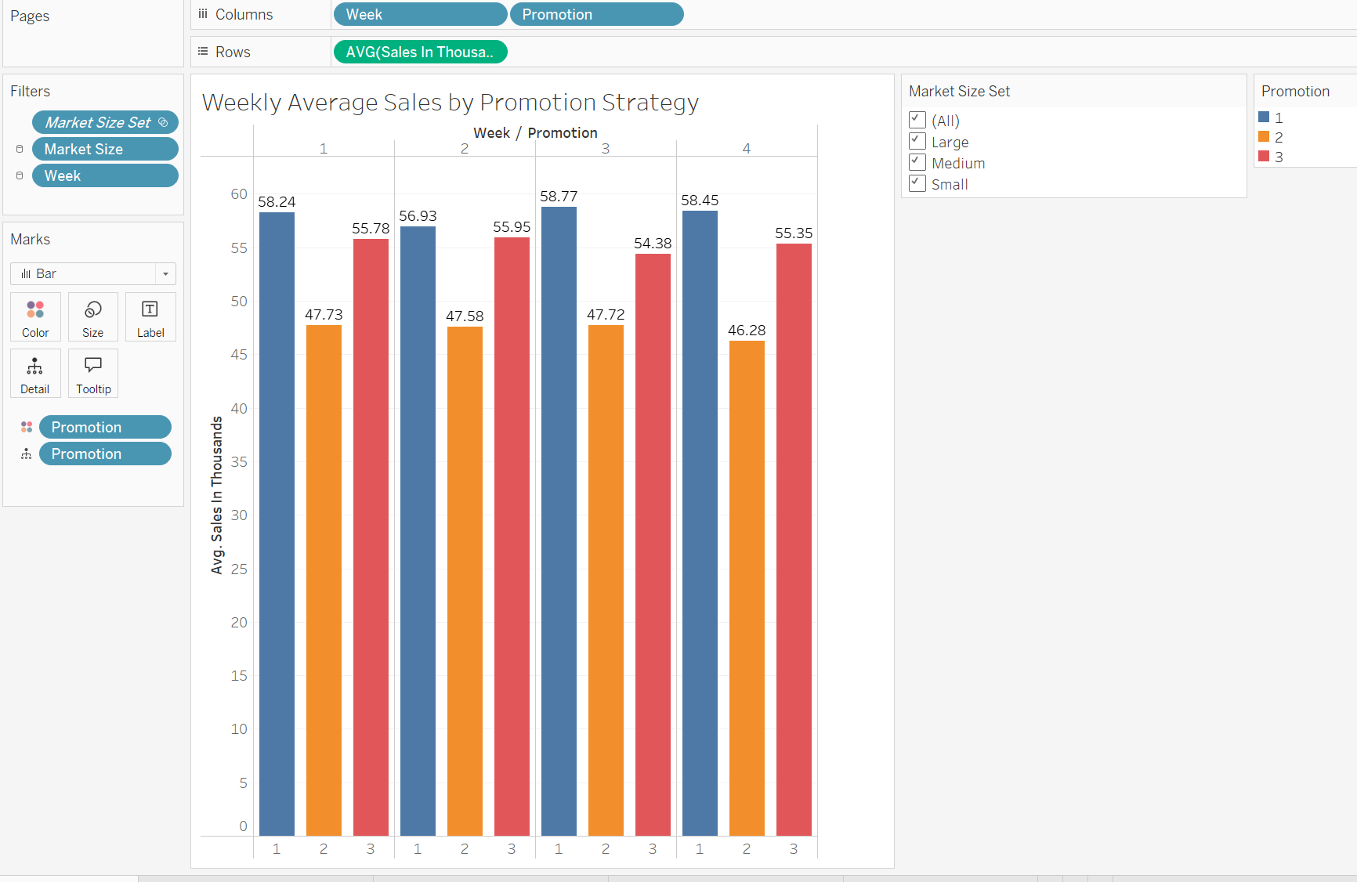
Explore and Analyze the Data
1. Weekly Average Sales by Promotion
Objective: Analyze which promotion had the highest average weekly sales over the 4-week campaign period.
💡 Key Insight:
Promotion 1 had the highest and most consistent weekly sales.
Promotion 2 consistently underperformed and dropped in Week 4.
Promotion 3 remained competitive but slightly behind Promotion 1 overall.

Slide 7
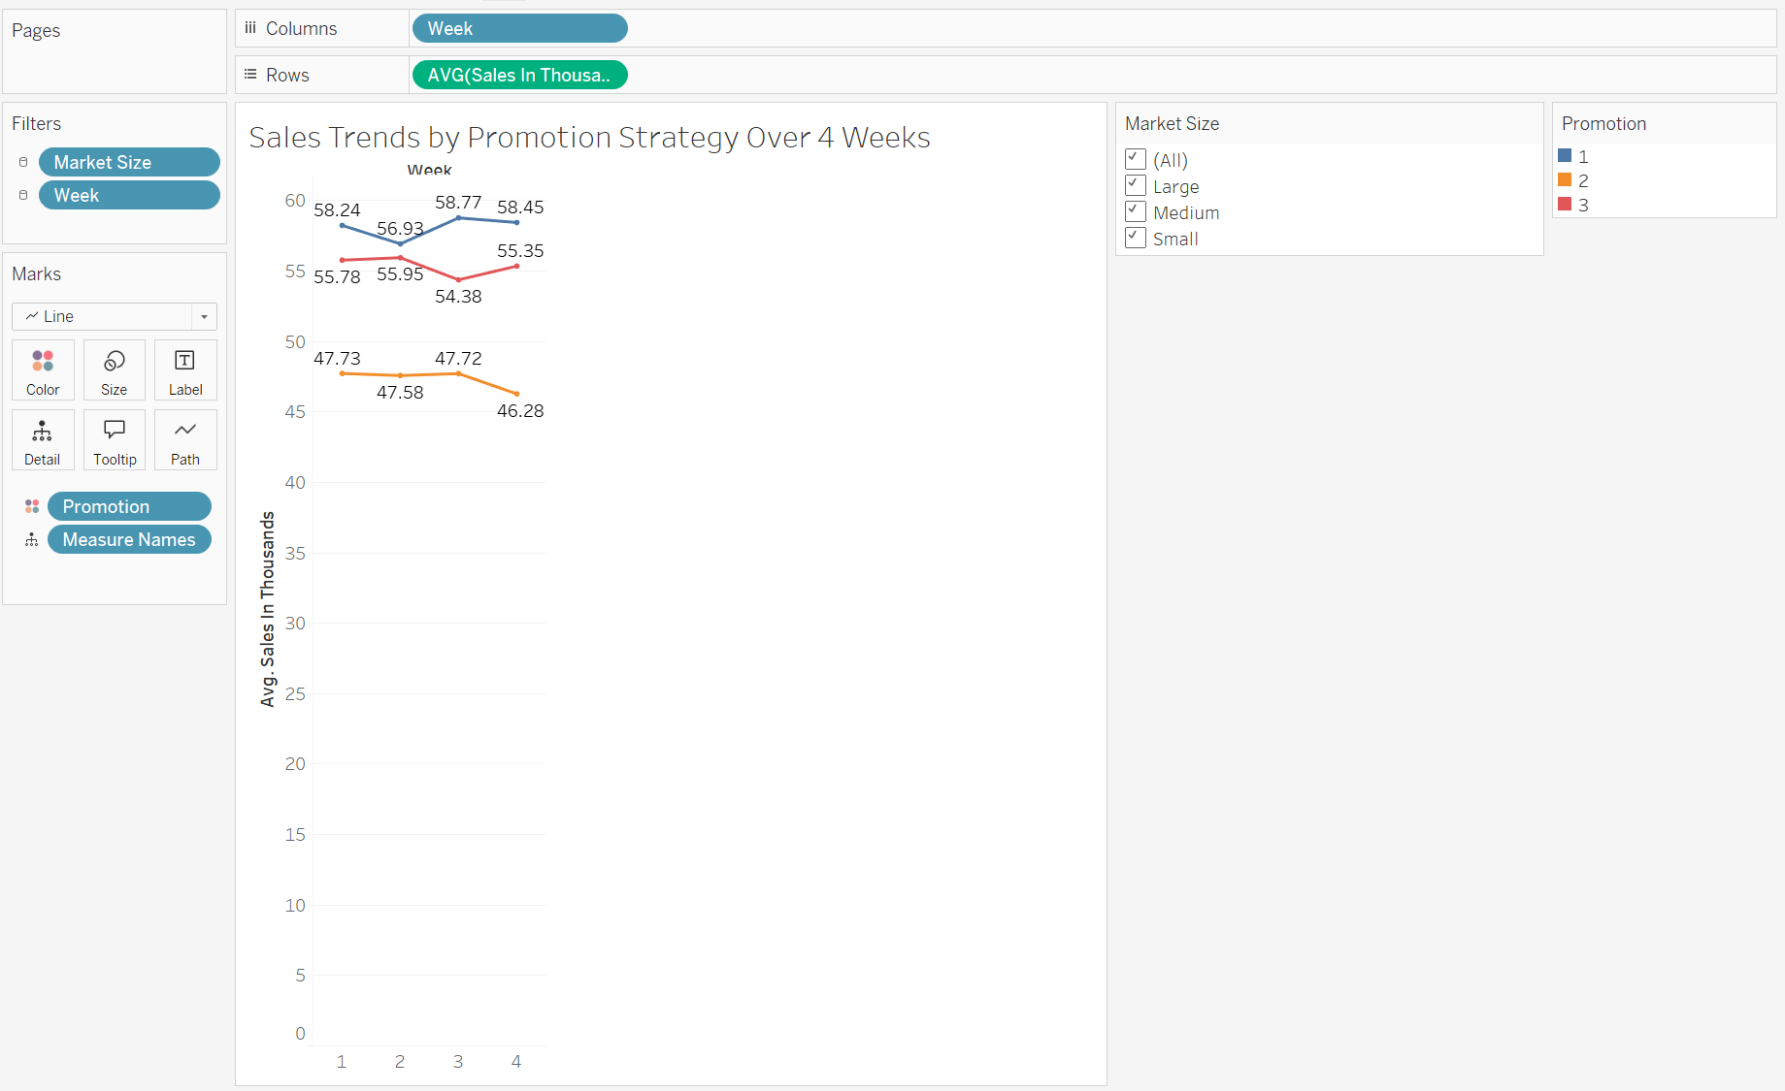
Explore and Analyze the Data
2. Sales Trends by Promotion Strategy
Objective: Visualize how average sales for each promotion evolved over the 4-week campaign period to assess consistency, momentum, or decline.
Key Insights:
🔹 Promotion 1 (Blue)
Started at 58.24K, dipped slightly in Week 2, peaked at 58.77K in Week 3, and finished at 58.45K
The numbers stayed close across all four weeks
✅ Conclusion: Promotion 1 showed strong and steady performance, with minor variations
🔺 Promotion 3 (Red)
Began at 55.78K, increased slightly in Week 2, dropped in Week 3, then rose again in Week 4
✅ Conclusion: Promotion 3 had some fluctuation but overall stayed stable and competitive
🔻 Promotion 2 (Orange)
Started at 47.73K, dipped in Week 2, had a small increase in Week 3, then fell to 46.28K in Week 4
✅ Conclusion: Promotion 2 showed early inconsistency and a clear drop at the end, making it the weakest performer
Sales Pattern Overview
Promotion 1 stayed steady — it had consistent performance each week.
Promotion 3 was stable but dropped slightly in Week 3.
Promotion 2 had small ups and downs, but dropped noticeably in the final week showing it didn’t hold customer interest over time.

Slide 8
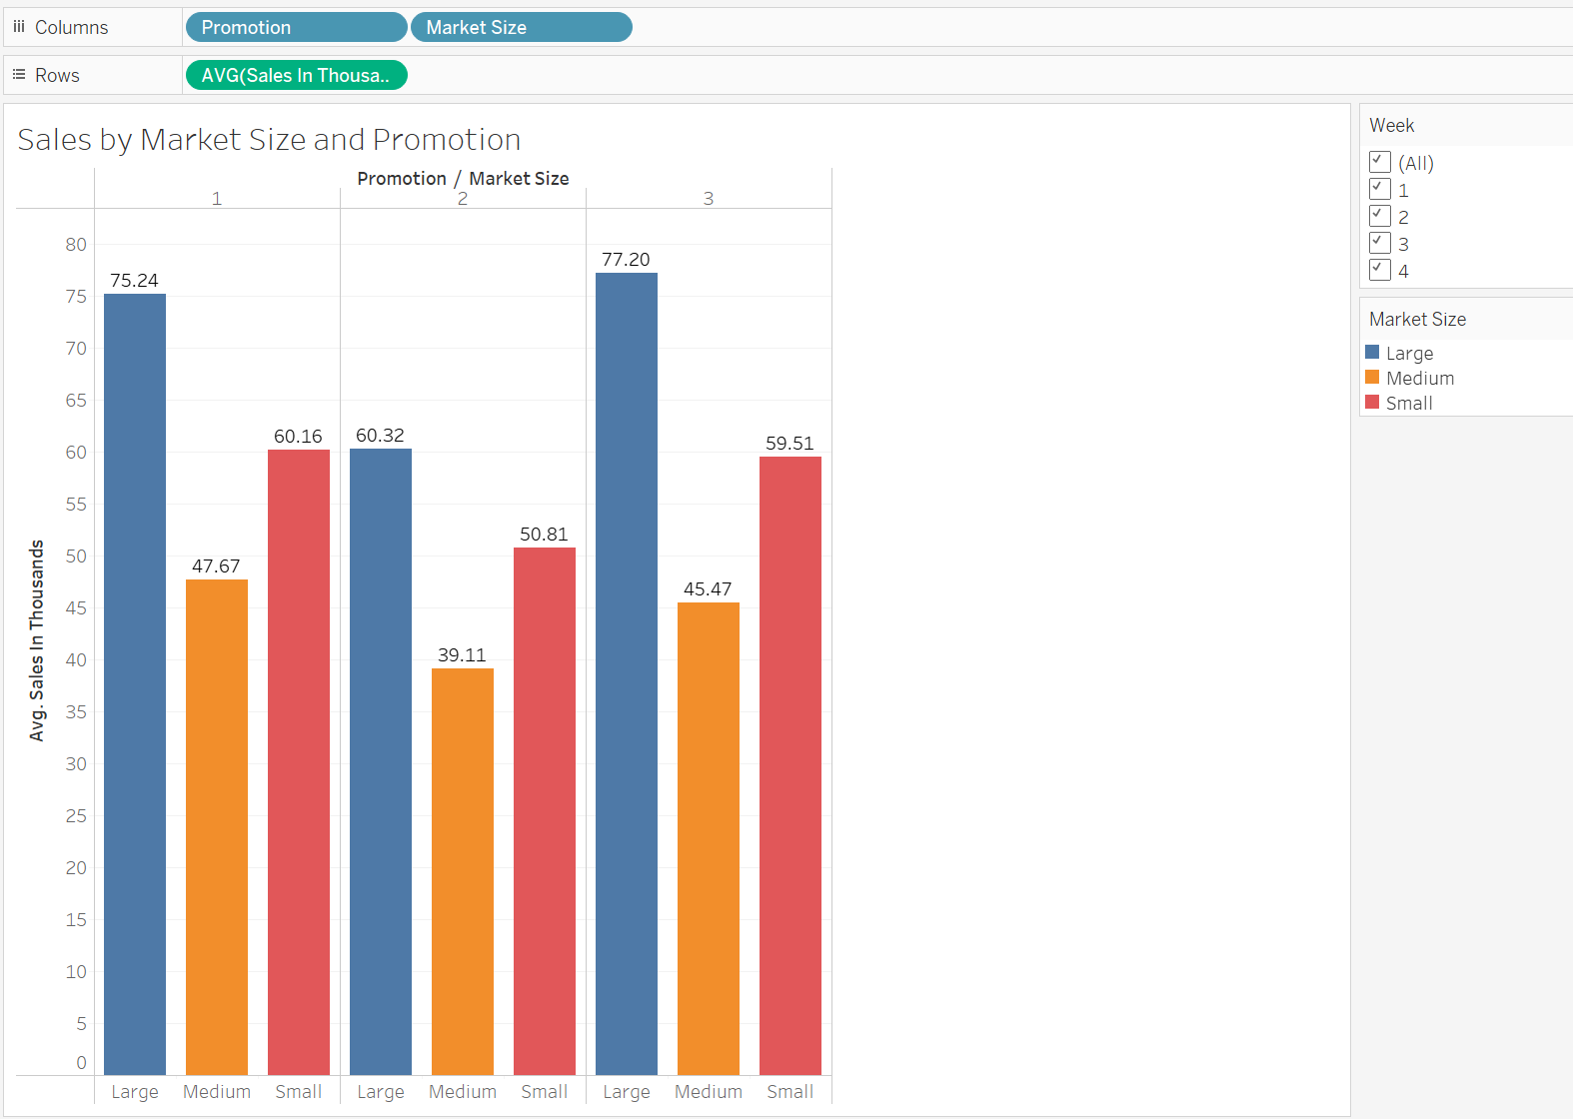
Explore and Analyze the Data
3. Sales by Market Size and Promotion
Objective: Understand how each promotion performed in large, medium, and small markets to support targeted marketing strategies.
Large Markets
Promotion 3 had the highest average sales at 77.20K Followed by Promotion 1 (75.24K) and Promotion 2 (60.32K)
✅ Conclusion: Both Promotion 3 and 1 worked well, but Promotion 3 was the top performer
Medium Markets
Promotion 1 remained in the lead at 60.16K
Promotion 3 was second (50.81K), and Promotion 2 had the lowest (39.11K)
✅ Conclusion: Promotion 1 is clearly the best choice for medium markets.
Small Markets
Promotion 1 had the highest average sales: 60.16K, Promotion 3 followed closely with 59.51K, Promotion 2 was lowest at 50.81K
Promotion 1 slightly outperformed Promotion 3 here.
✅ Conclusion: Promotion 1 edges out in small markets too. Promotion 3 was a close second, suggesting it could still work in some small-market contexts.

Slide 9
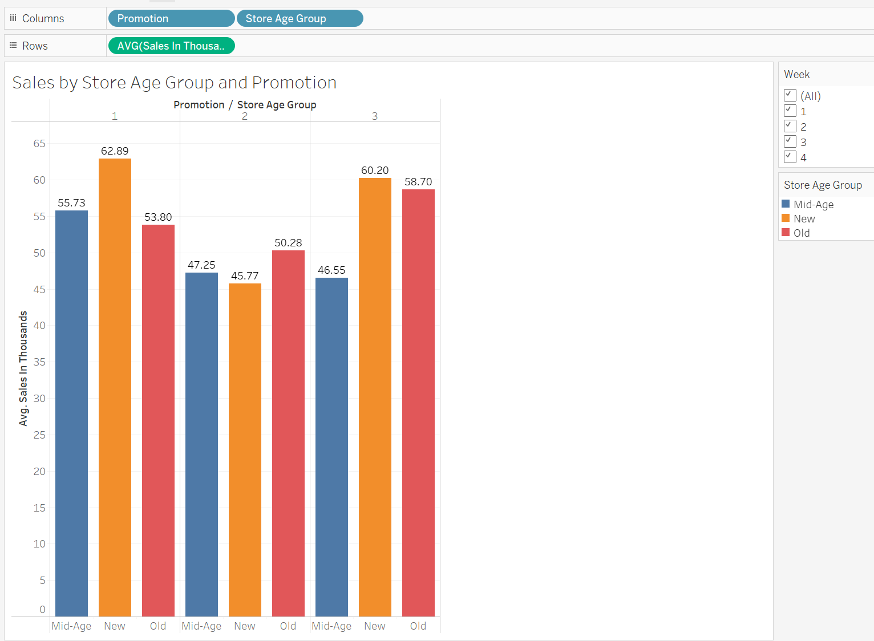
Explore and Analyze the Data
4. Sales by Store Age and Promotion
Objective: Does store age impact the effectiveness of a promotion?
New Stores
Promotion 1 had the highest sales at 62.89K, followed by Promotion 3 at 60.20K & Promotion 2 was lowest at 45.77K
✅ Conclusion: Promotion 1 is the best choice for new stores, with Promotion 3 also performing well.
Mid-Age Stores
Promotion 1 leads again at 55.73K, Promotion 2 at 47.25K & Promotion 3 at 46.55K
✅ Conclusion: Promotion 1 clearly outperforms others in mid-age stores.
Old Stores
Promotion 3 had the highest sales at 58.70K, Promotion 1 at 53.80K
& Promotion 2 at 50.28K.
✅ Conclusion: In older stores, Promotion 3 is the top performer.
Sales Pattern Overview
Promotion 1 performs best in new and mid-age stores
Promotion 3 is the strongest in old stores
Promotion 2 ranks lowest across all store age groups

Slide 10
📉 Key Insights 💡 What Did I Find?
📊 Promotion 1 had the highest average weekly sales and performed best in new and mid-age stores. It also ranked #1 in medium and small markets.
📊 Promotion 3 was the top performer in large markets and old stores, and closely followed Promotion 1 in small markets.
📉 Promotion 2 consistently underperformed and showed a clear decline by Week 4 across all market sizes and store types.
🌍 Large markets, medium markets, and new stores responded most strongly to Promotion 1.

Slide 11
Dashboard Walkthrough Interactive Dashboard Highlights
An interactive Tableau dashboard was created to explore weekly sales trends, market performance, and promotion effectiveness across different store types.
🔗 View the Dashboard:
👉 Link
The dashboard allows users to compare promotions by week, market size, and store age group to get detailed insights.
Designed for non-technical users, it includes clear visuals, color-coded charts, and tooltips for quick understanding.

Slide 12
Strategic Recommendation Summary
🚀 Promotion 1 should be deployed nationally, especially in new and mid-age stores and in medium and small markets, where it showed the strongest results.
📍 Promotion 3 is best suited for large markets and older stores, and is recommended for targeted use in those segments.
⚠ Promotion 2 underperformed in all segments and is not recommended for rollout.
Notes:
Based on key insights

Slide 13
Next Steps & Reflection 🚀 What’s Next?
Recommend deploying Promotion 1 nationally based on strong results in new/mid-age stores and most market sizes
Use Promotion 3 in targeted campaigns (e.g., large markets and older stores)
Explore adding geographic filters or customer-level data in future iterations
Notes:
Recommend deploying Promotion 1 nationally based on strong results in new/mid-age stores and most market sizes
Use Promotion 3 in targeted campaigns (e.g., large markets and older stores)
Explore adding geographic filters or customer-level data in future iterations
Learned to build clear, stakeholder-ready dashboards in Tableau
Project added to GitHub portfolio and Tableau Public

Slide 14
Conclusion Project Impact & Value
🔍 What This Project Demonstrates:
✅ My ability to analyze business problems using real-world data
✅ Skill in building stakeholder-ready dashboards with clear, interactive visuals
✅ Experience identifying data-driven marketing recommendations
✅ Understanding of how promotion performance varies by market and store type
How This Adds Value:
🔹 Helps marketing teams make smarter decisions with targeted campaign strategies
🔹 Shows how data can reduce wasted budget by avoiding underperforming promotions
🔹 Highlights how filtering by customer segments reveals deeper insights
🔹 Proves I can turn data into actionable recommendations, not just charts

Slide 15
“Thank you!
Any questions?”

